Slide 1


Bike Sales Operational
Performance Analysis
Operational Performance Dashboard: Delay Analysis, Sales Insights & Strategic Recommendations for Executive Leadership
Presented by Soumallya Roy

Slide 2
EXECUTIVE SUMMARY
Significant operational pressure has led to a critical spike in delivery delays, primarily concentrated in high-revenue states and top-tier brands.

Slide 3






KEY OPERATIONAL METRICS
Delay Surge
Order Impact
Customer Risk
Overall delay rate increased from 17.14% to 41.18% in the current month.
28 out of 68 orders delayed last month, signalling a 24% increase in operational load.
Increased delays are directly impacting sales conversion and long-term customer satisfaction.

Slide 4

DELIVERY PERFORMANCE STATUS
41%
Current Delay Rate
Status: CRITICAL
Operational pressure has reached a tipping point. Structural bottlenecks are preventing timely fulfillment for nearly half of all incoming orders.
Critical threshold exceeded.

Slide 5
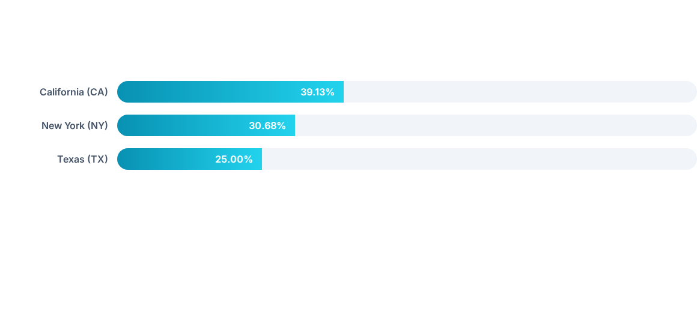
INSIGHTS BY GEOGRAPHIC ZONE
Note: CA and NY are likely impacted by supply chain congestion, warehouse workload, or transport vendor delays. TX remains comparatively stable.

Slide 6
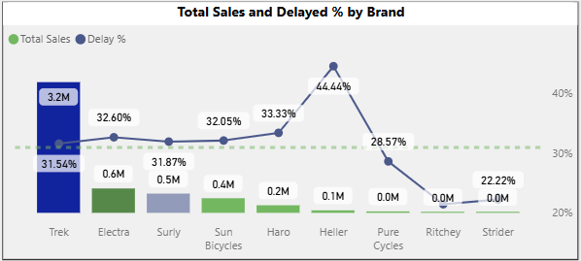
BRAND PERFORMANCE - TREK
Revenue Leader Under Pressure
Trek drives the highest revenue ($3.2M) but faces a significant 31.54% delay rate.
Top sellers (Domane SLR series) show 36–37% delays, indicating systemic fulfillment issues rather than SKU-specific problems.

Slide 7
TOP HIGH-RISK PRODUCT SKUS
Product Family | Brand | Delay Rate | Risk Assessment
Electra Townie (Series) | Electra | 51.11% | High / Structural
Trek Domane SLR 6 Disc | Trek | 37.04% | Medium / Bottleneck
Surly Karate Monkey | Surly | 36.00% | Medium / Systemic
Trek Emonda S 4 | Trek | 37.04% | Medium / Supply Chain

Slide 8
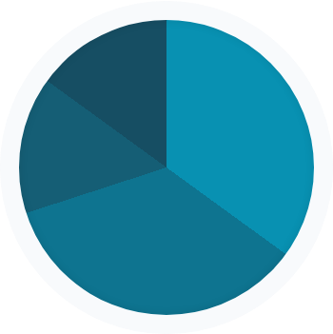
REVENUE PROPORTIONS VS. DELAYS
Road Bikes: $1.5M Rev | 32.1% Delay
Mountain Bikes: $1.5M Rev | 32.6% Delay
Revenue
Cruisers: Moderate Rev | 31.3% Delay
Electric Bikes: Growth Vol | 28.7% Delay

Slide 9
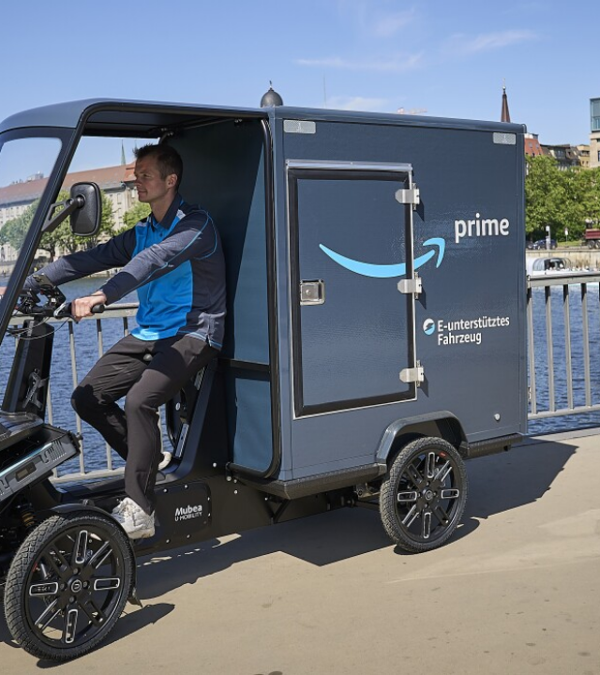
SUPPLY CHAIN STRESS
Infrastructure Constraints
Operational inefficiencies are concentrated on a small number of high-demand items rather than across all inventory.
Warehouse workload and carrier allocation in CA and NY hubs have reached maximum capacity, leading to the 40%+ delay spike.

Slide 10
OPERATIONAL INTERVENTIONS
Prioritize High-Revenue SKUs: Fast-track fulfillment for Trek and Electra top-sellers through dedicated picking lanes.
Warehouse Reallocation: Shift buffer stock to CA and NY regional hubs to reduce last-mile timing risk.
Carrier Optimization: Review and renegotiate SLAs with alternative delivery partners in high-delay regions.
Dynamic Planning: Implement real-time stock planning to anticipate spikes in Comfort and Road bike order cycles.

Slide 11
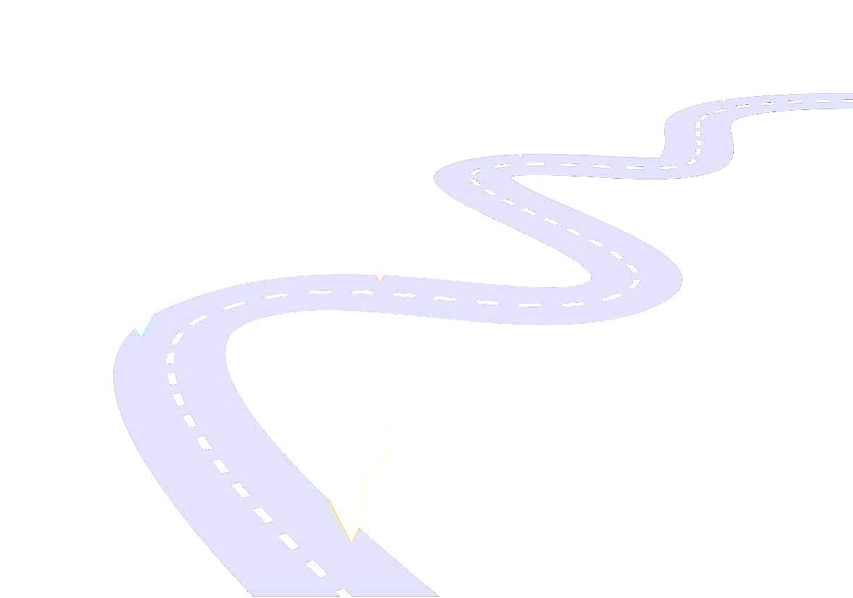
EXECUTION ROADMAP
Immediate (Week 1-2)
Short-Term (Month 1)
Mid-Term (Quarter 2)
Fulfillment lane prioritization for high-value brands (Trek/Electra) and CA regional audit.
Onboarding alternative logistics partners and implementing regional buffer stock strategies.
Full integration of dynamic stock planning tool to maintain delay rates below 15%.

Slide 12


Any Questions?
Operational Performance Dashboard & Strategic Analysis
Soumallya Roy
Operational Performance Lead

